Slide 1
MP968 Workshop: Experimental Design
Dr Leighton Pritchard
leighton.Pritchard@strath.ac.uk

Slide 2

Register for NC3Rs EDA
https://eda.nc3rs.org.uk/
https://sipbs-compbiol.github.io/MP968-Workshop_Experimental_Design

Slide 3
Learning Objectives
After this workshop I hope you will be able to…
Understand and explain the relationship between measurements, statistics, and experimental design.
Understand and explain that statistical models are devices that process data to produce estimates that support scientific insight.
Understand how assumptions and expectations about factors influencing an experiment are translated into effective experimental designs.
Use G*Power to estimate a group size for a statistical test.
Use the NC3Rs Experimental Design Assistant to lay out and analyse a simple experiment, and share the design information.
Notes:
This workshop is an introduction to…
the way your data collection is subject to factors that affect all measurements
how the biological or physical process you are studying affects the data you collect
making assumptions about causal factors in your data explicit
using experimental design to improve data collection, exclude influences you are not scientifically interested in, and minimise the number of experimental subjects required to test a model
how to use the NC3Rs Experimental Design Assistant (EDA) to lay out and analyse an experimental design
What this workshop is not
Yet another introduction to t-tests, means, and standard deviations
A guide to how you should design or analyse any specific experiment
Advocacy for any particular statistical method, software, or tool
An exhaustive presentation of statistics or training in statistical methodology

Slide 4
Introduction
Experimental design and Statistics for people who would rather not be doing Statistics
Notes:
We are going to take a close look at the fundamental issue we care about when performing a scientific experiment: cause and effect: e.g. “does this new drug actually reduce blood glucose concentration?”
Administering the drug is the cause
Reduction in blood glucose concentration is the effect
For this we need to be aware of something called Causal Inference, which is a large and separate field of study, but from which we will borrow some key ideas.

Slide 5

What we’d all rather be doing
We are interested in the world around us
Discovering how life and nature work
Finding ways to improve people’s lives/reduce disease burden
What we have to do
Collect data
Design experiments to give us useful data
Design experiments that do not cause unnecessary suffering (3Rs)
Carry out appropriate statistical analysis to make the data scientifically useful
Notes:
The workshop is, effectively, a very short statistics primer for people who would rather not be doing statistics. What I think you’d prefer to be doing is carrying out experiments and researching the effectiveness of drug treatments or formulations, or measuring some kind of effect on complex biological systems.
In order to do this, we need to collect data.
To collect data, we often need to design experiments to give us useful data.
Importantly for animal research, we need to design experiments that do not cause unnecessary suffering – which means not using more animals than are necessary to give use sound data in an experiment.
And we need to carry out appropriate statistical analyses _competently_ to make the data useful in a scientific context.

Slide 6

The case for Statistics
We have models of the world around us
Our understanding of cause and effect is a model
We express our understanding with scientific models
Our experiments are models
We connect data to models with Statistics
A branch of Applied Mathematics
How we understand our experiments guides statistical analysis
We can make Statistics serve scientific enquiry
Notes:
I think that what we really want to do is collect data about our systems, then connect the data we collect with scientific models (which may or may not be mathematical) that might explain whether a drug is effective, if some new formulation improves drug availability, or some other clever thing with great potential to improve society.
The way we connect the data you collect with those scientific models is by using a branch of Applied Mathematics called Statistics. But this workshop is not about “learning Statistics” as a topic. Instead we’ll be thinking about the use of Statistics as a way to understand and process data collected by scientific investigations, and how what we understand about the science - and especially how we express this understanding through the design of our experiments - motivates and guides statistical reasoning.

Slide 7
Cause and Effect
The experimental data you collect does not contain information about cause and effect

Slide 8
Science before Statistics
For statistical models to provide scientific insight, they require additional scientific (causal) models.
The reasons for a statistical analysis are not found in the data itself – they are found in the causes of the data.
The causes of the data cannot be extracted from the data alone.
We have to design the right experiment and statistical model to give us the estimate we need.
Notes:
Statistics is often taught in the absence of scientific models: how to do a t-test, how to calculate a Pearson’s correlation coefficient and so on.
We’re not going to do that.
We’re not doing that because statistical models are only tools that process data to produce estimates.
For statistical models to be useful to us as scientists they must have some kind of logical connection to a scientific model.
So we’re going to consider scientific models, which we call _causal models_
They are called causal models because we expect, or believe, that changing some variable or value in the model will change the values of some other variables.
If we modify the concentration of a drug, we expect that the effect of that drug changes.
The concentration of the drug is the cause of the effect size we see.
Now, we could take the data we collect for any experiment and analyse it statistically
But the interpretation of the experiment, in terms of cause and effect, comes entirely from the researcher and their understanding of the experimental design.
We could in principle obtain exactly the same values in an experiment for differences in drug effect as for differences in height as a result of diet.
The numbers would be the same, but the causes and effects would be different.
The causes of the data are not present in the data alone: they come from the researcher.
We need to design the right statistical model to give us the estimate we need.

Slide 9
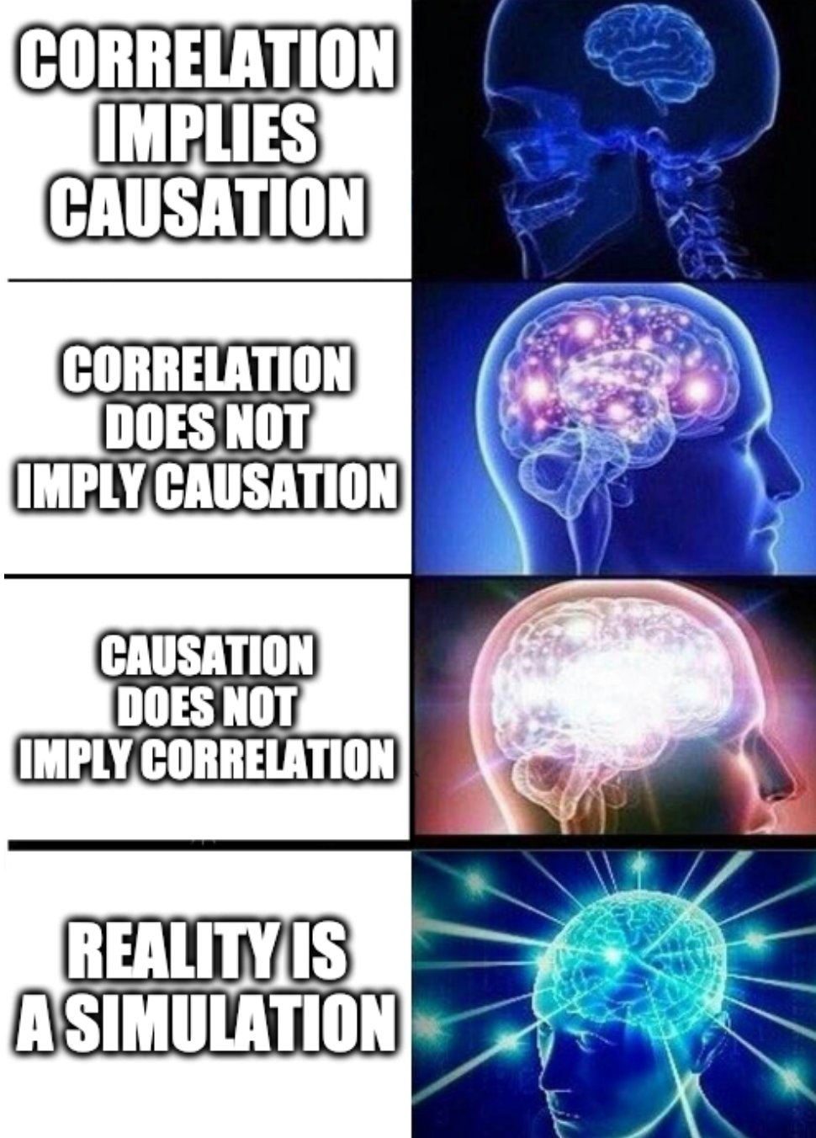
Causal Inference
Correlation is not causation
https://www.tylervigen.com/spurious-correlations
Statistical analysis identifies associations, which can run in either direction
Causal inference is prediction of consequences of intervention
“If I increase drug dose, blood glucose falls further”
Causal inference is imputation of unobserved interventions
“I observed a change in marker level, so kidney function is altered”
Notes:
Causal inference is a huge and fascinating topic, and I recommend “Causal Inference in Statistics: A Primer” if you want to learn more. All we can do today is gain a little intuiution about the topic.
You will have been told many times that correlation is not causation.
This is true.
It turns out that causation doesn’t even imply correlation, but we don’t have time to get into that.
Statistical analysis usually identifies associations: drug concentration goes up, glucose concentration goes down
But this does not have direction – we can’t tell from the analysis whether the drug affects the glucose concentration, or vice-versa
Association is just a statistical measure
Causal inference is the kind of analysis that tells you when there is _directionality_ of an effect
What I mean is that it predicts the consequences of making some kind of intervention
Like if you intervene to increase the dosage of a drug you _predict_ the change in blood glucose
Knowing a cause means you can predict the consequences of an intervention
And Causal Inference also allows us to “impute missing observations”
What this means is that we can infer the effect of an unseen cause

Slide 10



Notes:
As a more tangible example…
Storm Bert hit the UK over last weekend.
If you looked outside during Storm Bert and you could see any trees, then you would have seen the trees swaying.
If you live by the sea, you would have seen the waves crashing.
Now, you know that if you look outside and see trees sway and waves crash, that it’s the _wind_ causing the waves and the trees to move.
But if you measured tree movement, or wave strength, and wind velocity, you could only ever find a statistical association
There is nothing else about that data that tells you whether the wind causes the trees to move, or the trees move and cause the wind to blow
So where does the causal information come from?
It comes from you, as a person, and your expectations and beliefs about the nature of reality.
You know that if the wind blows harder, the trees will move more.
And you know that if you climb into the tree and shake it really, really hard – you won’t make the wind blow any stronger.
So your causal beliefs are what allow you to take that statistical association and make predictions.
Likewise, if you see the trees sway and fall over, from the safety and comfort of your wind-free home, you can infer that there is a strong wind blowing.
So your causal beliefs allow you to draw conclusions about events that you are not measuring or experiencing.

Slide 11
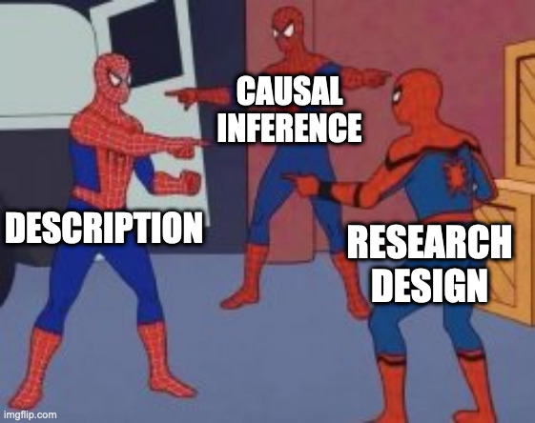
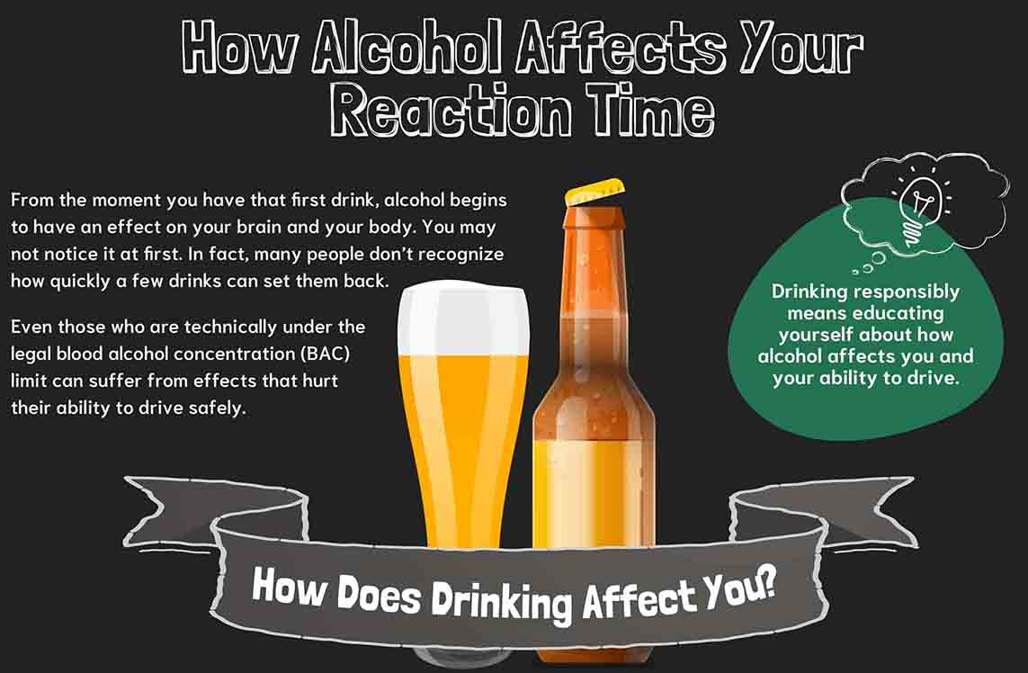
Causal Beliefs are Experimental Design
Notes:
In exactly the same way your beliefs about how the world works are your causal model for understanding whether trees make wind or wind blows trees,
Your beliefs about the system you are studying are your causal model for your experimental design
Suppose you set up an experiment to measure the association between alcohol consumption and reaction time.
The experiment goes well, and you find an association.
Your causal interpretation of that experiment – alcohol consumption _causes_ reaction time to get slower_ - is an expression of your understanding of the causal relationships of the system.

Slide 12
Measurement
Experimental measurements are estimates, and experimental design affects how good that estimate is
Notes:
We are going to think about what it means to measure some kind of value. You’re all scientists and you will have measured things before, so you might think that you should be working with more advanced material - I can sympathise with that.
We’re going to look at measurement in a way that emphasises the role of scientific modelling and explores the idea of an estimate as a distribution of more- or less-likely possibilities rather than a single point value, and how sample size influences the shape and interpretation of that distribution.

Slide 13

How wet is the Earth?
What proportion of the Earth’s surface is water?
Can we measure this exactly, or only estimate it?
If we’re estimating, how accurate is our estimate, and what affects the accuracy?
Notes:
The example we are using is attempting to answer the question What proportion of the Earth’s surface is covered by water?”
You probably already have an idea of what proportion that is - about 70%. But pretend that you don’t already know.
Even if you did already know, have you thought about…
How accurate is that value of 70%?
How would you go about measuring the exact surface area?
Aren’t there tides? And coastal erosion? And other things that might affect this?
Aren’t we really estimating the measurement?
The point of this section is to think about the implications of knowing that – although we do measure point values - we are only _estimating_ the underlying real quantities in our experiments.
For the purpose of experimental design, we need to understand what influences the accuracy of those experiments, so that we can take them into account in our analyses

Slide 14

How to measure the Earth’s surface?
Pour the water into a beaker?
Measure all coastlines with a ruler?
In person?
In satellite photos?
We can’t get an exact measure, so we need to estimate
Let’s spin the globe! (An experiment!)
Notes:
Suppose you want to measure the proportion of the Earth’s surface that is water. How would you go about it, practically? Maybe you could…
pour the water off into a large measuring cylinder.
(But there isn’t a container big enough)
take some time out of your studies and walk around the globe with a tape measure to find the cumulative distance around the edge of all the oceans, then calculate the area.
(But you can’t measure the length of a coastline. Due to the Coastline Paradox, coastlines have no well-defined length)
So, if we can’t find a way to absolutely, precisely measure the proportion of the Earth’s surface that is water, we must instead estimate it.
Suppose we have a globe that represents the Earth (Figure 5.2). Now if we spin it up in the air and catch it, then look at the spot where our right index finger lands, that finger will either be on land (L) or on water (W).
If we do this many times, we will gradually build up a set of data points that are water (W) or land (L). We can use this dataset to estimate the proportion of the globe that is covered in water.
PRACTICAL EXAMPLE – THROW THE GLOBE OUT INTO THE ROOM
RECORD THE W/L VALUES

Slide 15
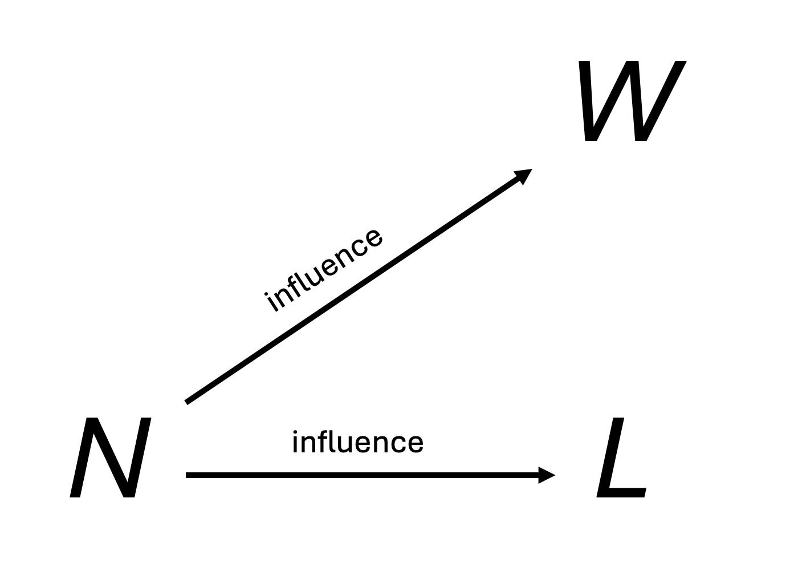
What affects our measurements?
We measure the number of times we hit “water” (W), and how many times we hit “land” (L)
These are our measured outcomes – dependent variables
The number of times we spin the globe and make a measurement, N
N is an independent variable
The more times we spin the globe, the larger W and L can be
Represent this with a causal graph
Notes:
W is the count of the number of times our index finger lands on water. We are observing this directly and assign it the letter W (for water).
L is the count of the number of times our index finger lands on land. We are observing this directly and assign it the letter L (for land).
The number of times we throw the globe and make a measurement is entirely under our control, and influences the measured outcomes of the experiment. The more times we toss the globe, the larger we expect W and L to get. We assign this variable the letter N (for number), and it is the independent variable in our experiment.
The values of W and L _depend_ on N, so are _dependent variables_; N is entirely under our control, so is _independent_.
The arrows inrepresent a causal influence of N on W and L because by varying N we can induce changes in W and/or L.
But, no matter what we do to change W or L (such as faking our data, or miscounting) this does not change N.
The arrows represent the expected consequence of intervening on the experiment by changing N

Slide 16
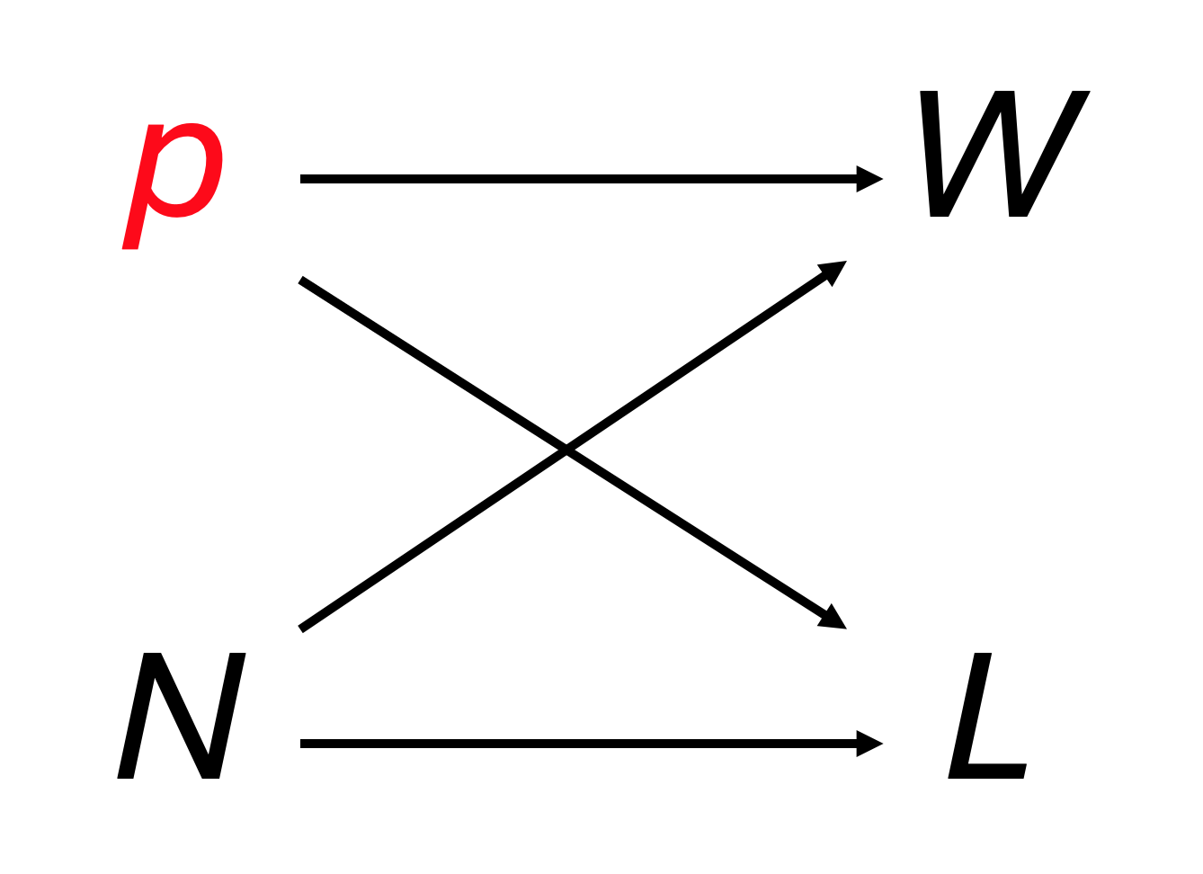
What affects our measurements?
p, our estimand, is a variable representing the proportion of the globe that is covered with water
We cannot directly observe this value.
We can only measure/estimate it indirectly
If p is large (more water on the Earth) we expect W to be large
If p is small (less water on the Earth) we expect L to be large
Notes:
The arrows in represent a causal influence of p on W and L because - in principle - by varying P we can induce changes in W and/or L.
Again, no matter what we do to change W or L (such as faking our data, or miscounting) this does not change p.
The arrows represent the consequence of intervening on the experiment by changing p (not that we can actually do this, in practice – the Earth has as much water as it has).

Slide 17
What the graph means
There is no arrow linking W to L or L to W
They are independent measurements that do not influence each other
We have the same probability of observing a W or L, regardless of the last observation
The graph does not tell us how p and N influence W and L, only that they can.
The researcher defines the relationships
Notes:
The graph in represents our scientific knowledge about the system. It shows that we understand:
The actual proportion of water p on the surface of the Earth affects our measured values W and L.
The number of times N we make a measurement (spin the globe) affects our measured values W and L
The graph does not tell us exactly how either p or N affect the values of W and L.
However, in this simple system, the nature of the relationships is intuitive:
every time we toss the globe we take a new measurement and increase either W or L by one
the actual proportion of water on the globe’s surface p should be reflected in the relative counts of W and L
It is good practice, for every experiment that you do, to draw out what you understand about the causal relationships in the experiment.
Drawing these graphs can help you understand your experiments better, and develop effective experimental designs. Considering these structures can identify good (and bad) controls for your experiments (though this is beyond the scope of the workshop).

Slide 18
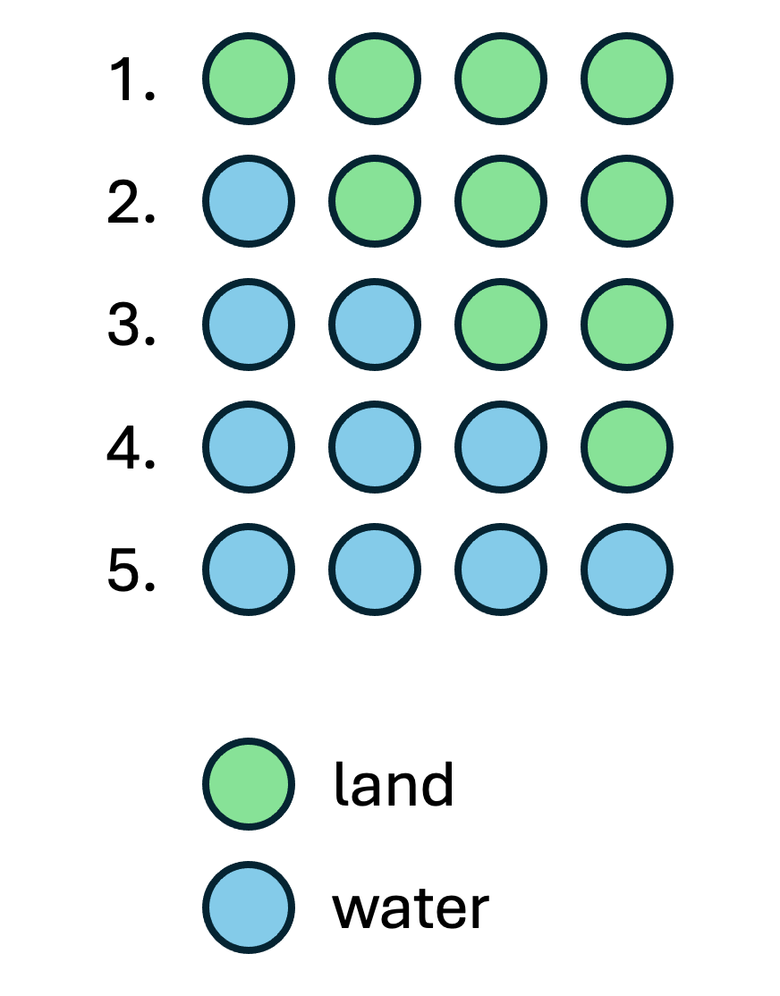

Tetrahedron Earth
Pretend the Earth is a tetrahedron.
Regular Platonic solid
Four faces
Each face can either be water (W) or land (L)
Notes:
We’re going to analyse our data statistically, in a way that I hope will give some intuition about the relationship between the quantity being estimated (for us, p, the proportion ofthe Earth’s surface that is water), the observed measurements (W and L, the counts of “water” and “land”), and the number of measurements N we take.
There are a lot of possible proportions of water on the actual globe, between 0 (all land) and 1 (all water). In fact there are an infinite number of possible proportions!
But that’s a bit much to start with, so let’s build up from a set of smaller possibilities.
We’ll begin by pretending that the Earth is a tetrahedron, to make the calculations simple
Each face of this Tetrahedron Earth can either be water or land. So there are five possibilities in total:
All four faces are land (0% water)
Three faces are land, one is water (25% water)
Two faces are land, two are water (50% water)
One face is land, three are water (75% water)
All four faces are water (100% water)
These are each different proportions of water, and possible explanations of the W/L observations we made

Slide 19
Plausible explanations
For each possible explanation of the sample, count all the ways the sample could happen.
Explanations with more ways to produce the sample are more plausible
For each possible proportion of water on the globe, count all the ways the observed sample of tosses could happen.
Proportions with more ways to produce the observed sample are more plausible.
(This is Bayesian statistics. Really)
Notes:
This is Bayesian statistics – but we won’t labour that point.
For now let’s just focus on identifying the most plausible “true” proportion of water on Tetrahedron Earth

Slide 20

A small dataset
Observations
L W L
Notes:
Suppose that we’ve made the first three observations in our sampling
L, W, L
for two “land” (L) and one “water” (W).
We want to calculate how many ways we could have seen this outcome (two L and one W), for each of the possible proportions for Tetrahedron Eaerth

Slide 21
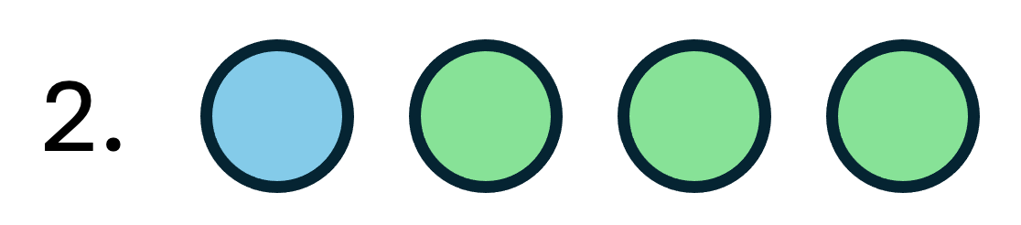
How many ways?
How many ways can the 25% water version of Tetrahedron Earth explain the observations?
Observation 1: L
3 “land” faces, so 3 ways to get this
Observation 2: W
1 “water” face, so 1 way to get this
Observation 3: L
3 “land” faces, so 3 ways to get this
Ways to explain the observations:
3 x 1 x 3 = 9
25% water Tetrahedron Earth
observations
Notes:
We’ll demonstrate the way the calculation works for a single possibility: where Tetrahedron Earth has a single “water” face, and three “land” faces. Let’s think about each of the observations in turn:
The first observation is L. There are three “land” faces, so there are 3 ways this result could have been generated.
The second observation is W. There is one “water” face, so there is 1 way this result could have been generated, so there are
ways that the first two results (L, W) could have been generated. The third observation is L. There are three “land” faces, so there are 3 ways this result could have been generated. This means that there are ways that the result sequence L, W, L could have been generated.

Slide 22
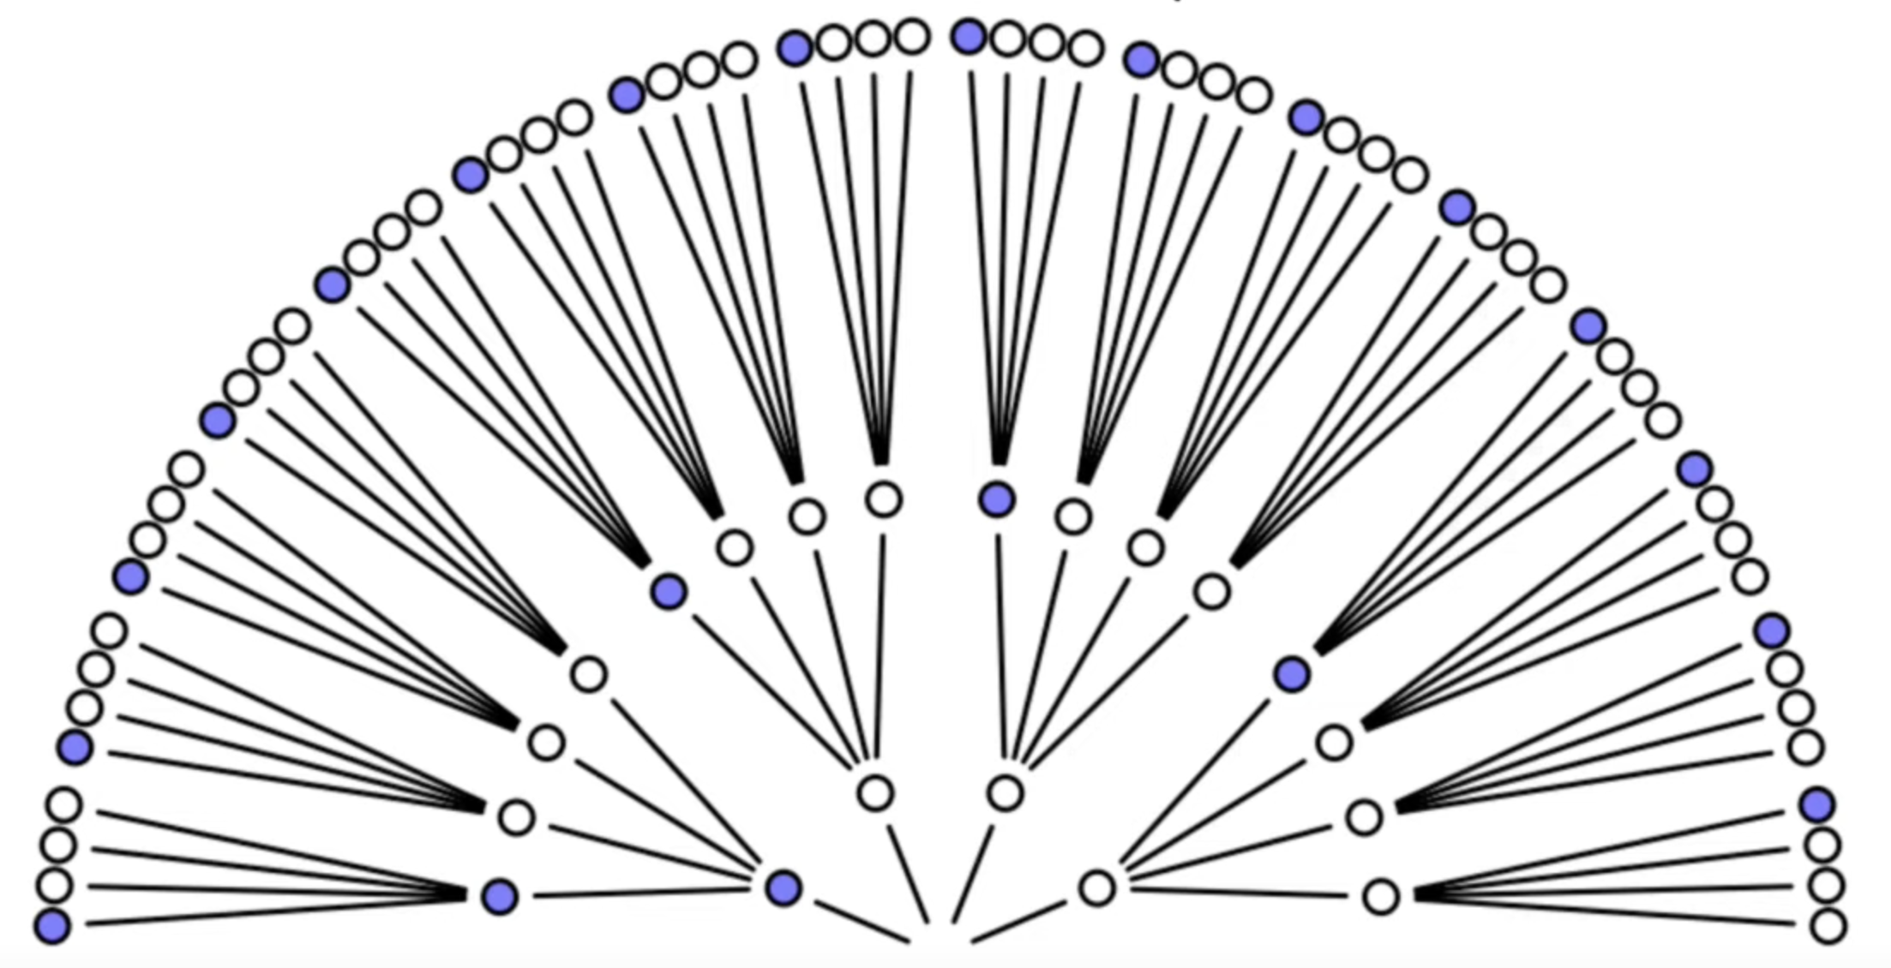
Why nine ways to make LWL?
Notes:
It may not be obvious why we multiply those values, but hopefully this might give you some intuition.
This graph shows all the ways we can make three observations of W or L on Tetrahedron Earth – W is blue, but L is white here
For the first draw, there is one way we can pick W, but there are three ways we can pick L
Now, regardless of what our first observation was, in every case we could still pick one W or any of three Ls
So there are 4 times 4 = 16 ways to generate two datapoints
Likewise there are four ways to generate the third observation, no matter what the first two observations were, for a total of 4 x 4 x 4 = 64 different outcomes.

Slide 23
Why nine ways to make LWL?
Notes:
Let’s trace the ways we could generate the LWL observations we actually have.
There are three options for us to pick W as the first observation, so at this point there are three ways we could have generated the data.
For the next observation, we _must_ have seen one of the three Ls in the previous draw, and now each of those links to only one W, so there are 3 x 1 ways to pick LW as observations
For the third observation, we _must_ have seen LW in the first two rounds, and each of the Ws links to three possible Ls, for a total of 3 x 1 x 3 different ways of generating the sequence LWL

Slide 24
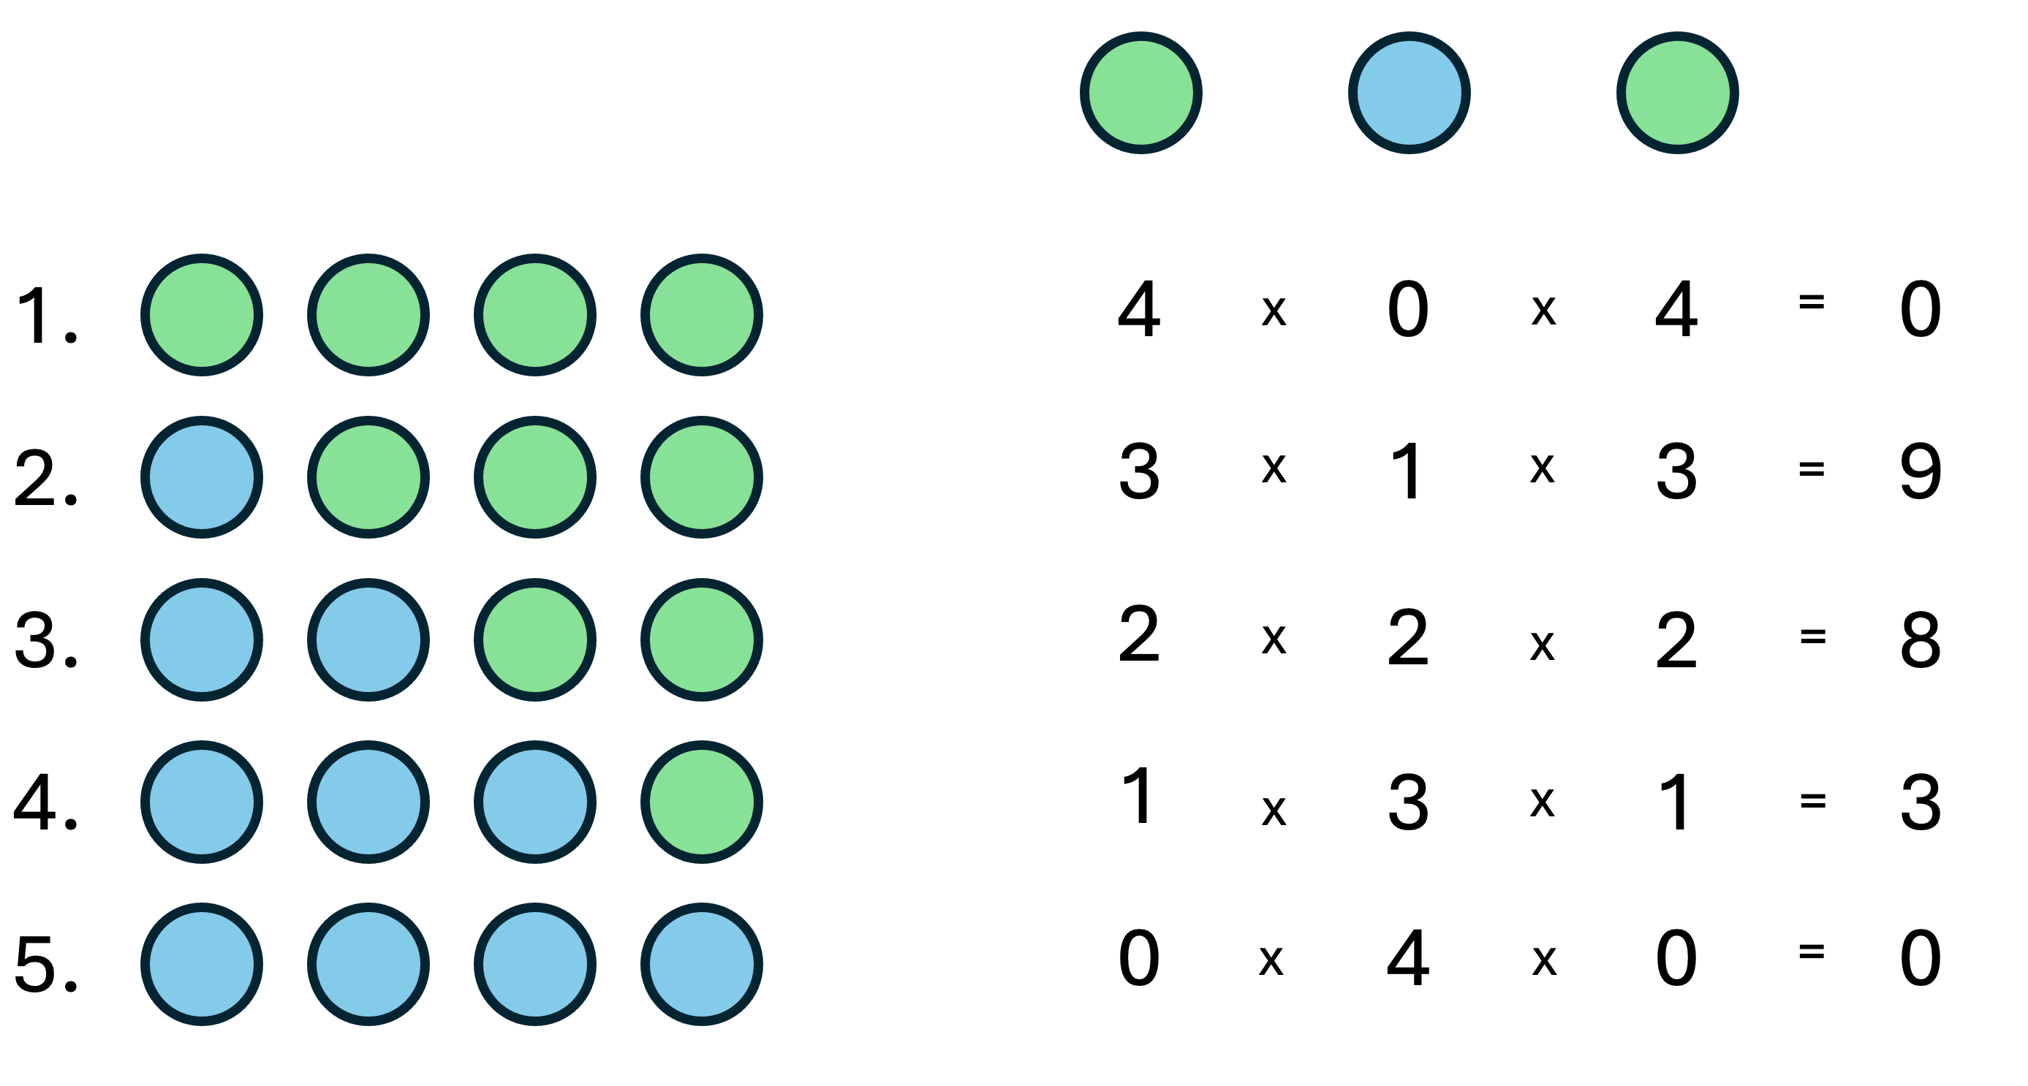
The most plausible Earth
We can repeat this for all possible configurations of Tetrahedron Earth, to calculate the most plausible configuration
This is the most plausible value for p, the proportion of water on Tetrahedron Earth’s surface.
25% water is the most plausible (9 ways)
But 50% water is almost as plausible (8 ways)
We have a distribution of plausibility
Notes:
There are no ways that an “all-water” or “all-land” Earth could produce this outcome: they are completely inconsistent with the evidence.
The 25% water possibility can give rise to the observations in nine ways
the 50% water planet in eight ways
and the 75% water planet in 3 ways.
The 25% water planet can give rise to the observations in the greatest number of ways, so is the most plausible explanation of the data.
What really matters is not the largest count, but the relative sizes of the counts.
Right now, the 25% water and 50% water planet options have very similar counts. T
his is due to the small sample size, so there’s not a lot of evidence about which of the two options is most likely.
It is difficult to decide which is the most plausible planet, really
We’d have to collect more data
This is a good feature of statistical analysis. We don’t want our analysis to be overconfident with small samples.

Slide 25
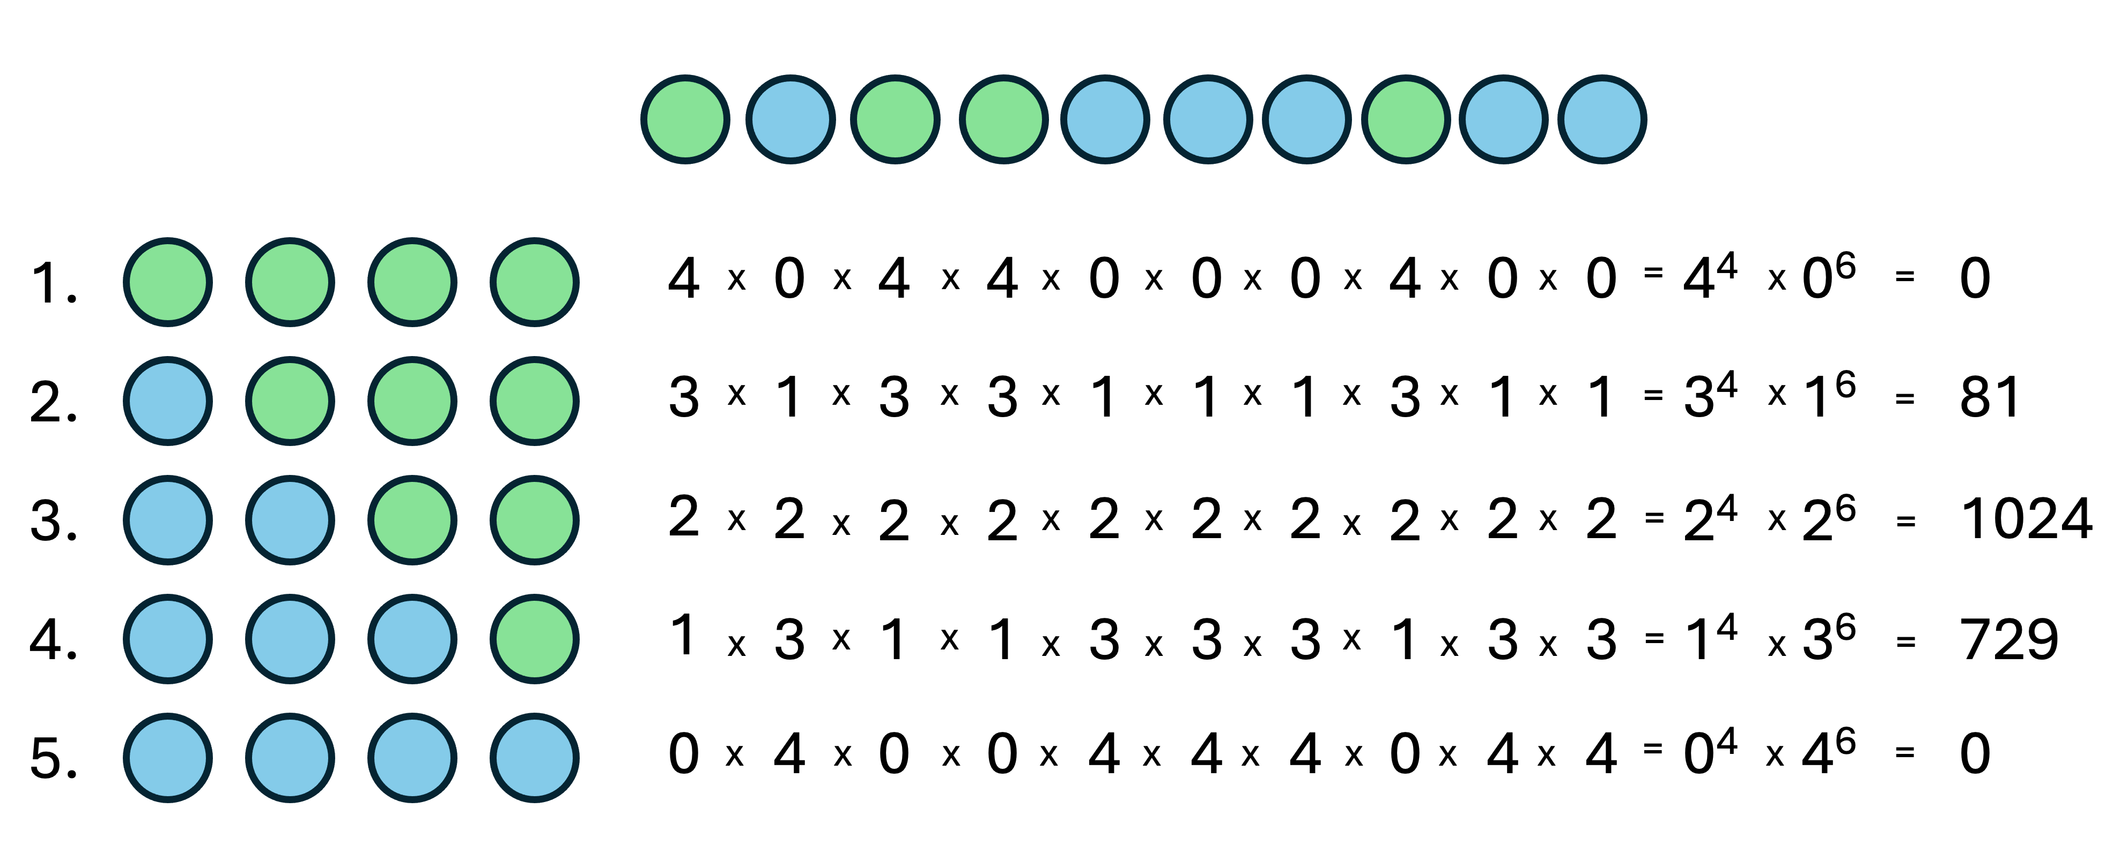
Make more observations
Notes:
Let’s consider a set of ten observations: L W L L W W W L W W.
We can repeat the analysis above, to see what difference having more data makes to the plausibility of each possible Tetrahedron Earth
There are still no ways that an “all-water” or “all-land” Earth could produce the observations.
The 25% water possibility can give rise to the observations in 81 ways;
the 50% water planet in 1,024 ways;
and the 75% water planet in 729 ways.
The 50% water planet can give rise to the observations in the greatest number of ways, so is the most plausible explanation of the data.
The availability of more data has changed our assessment of the most plausible planet.

Slide 26
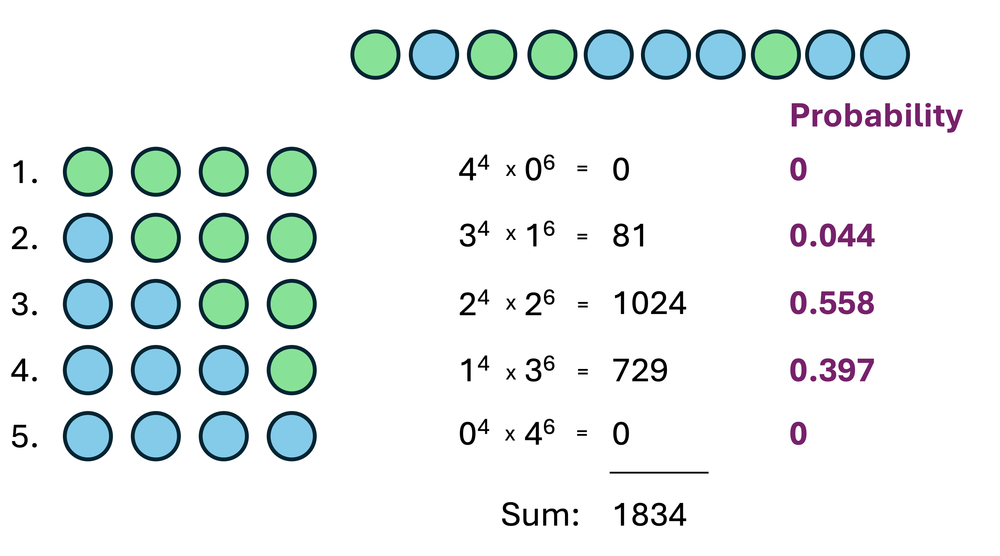
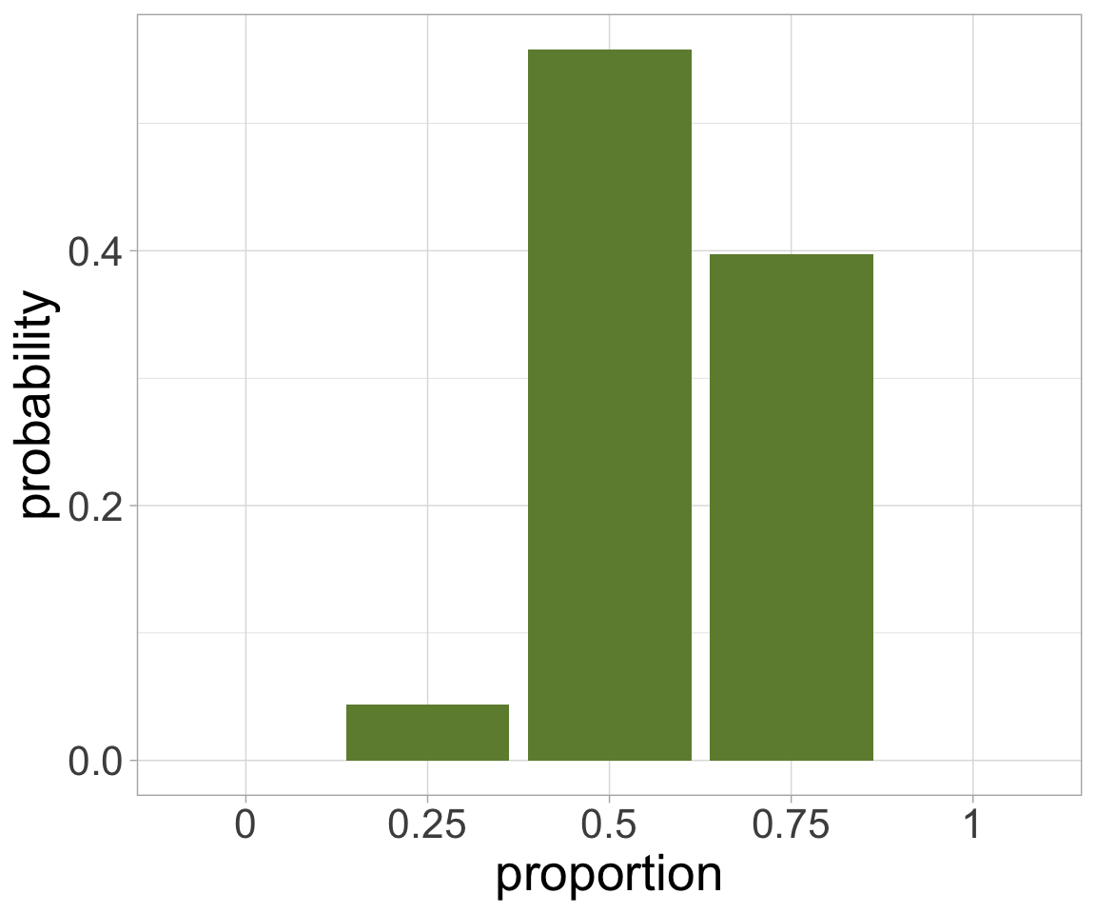
The most probable planet?
Notes:
In Statistics we tend to deal with probabilities, and it is useful and usual to convert our evaluation of the most plausible explanations into probabilities
The probability of an outcome is the proportion of all relevant events that we would expect to have that outcome.
For example, a fair coin has two sides: Heads and Tails.
There are two possible outcomes, and “Heads” is one of them, so we would expect the outcome “Heads” to occur about 50% = probability 0.5 of the time.
In exactly the same way, we simply take the sum of ways our sample can be produced (which is 1834) and, for each possible planet, divide the number of ways it could generate the sample by that total.
This gives us the probability we should assign to each version of Tetrahedron Earth having given us the observations we saw.
Having calculated probabilities for the most likely configuration of Tetrahedron Earth, given the data we collected, it appears that there’s a 56% probability that it has two water faces, and 40% probability that it has three water faces.
We are still working with a small sample size, and these two outcomes have similar probabilities.

Slide 27
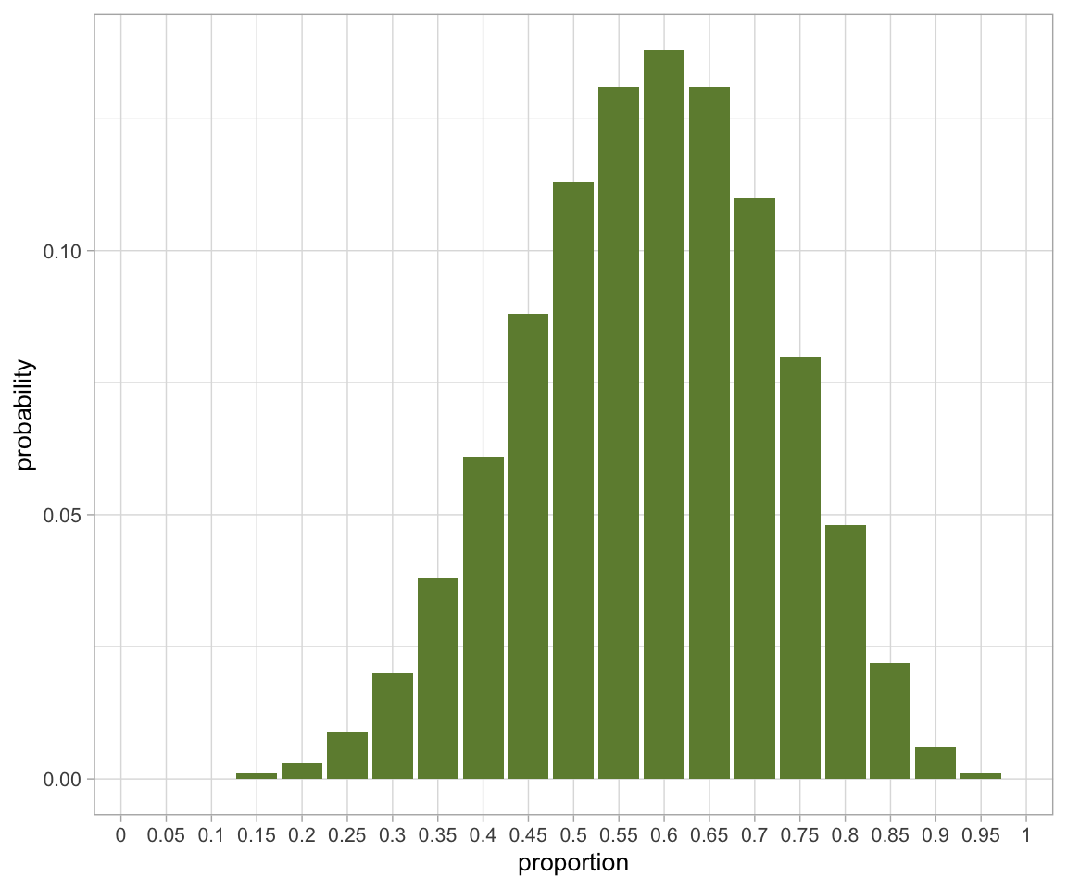
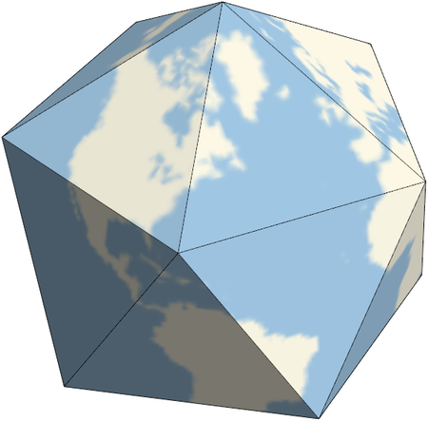
Icosahedron Earth
Notes:
Of course, the Earth isn’t a tetrahedron, but an oblate spheroid, and there are an infinite number of points we could measure on its surface, not just four distinct faces.
To get closer to this shape, we’re going to change our model from a tetrahedron to another regular Platonic solid: am icosahedron, with 20 faces.
We define that Icosahedron Earth has 20 faces, with each face being either “water” (W) or “land (L). This implies that there are 21 possibilities, from”all water,” through “one land, 19 water,” all the way to “all land.”
Changing our model of the Earth to Icosahedron Earth, with 20 faces, is still artificial. But it will allow us to see the shape of the probability distribution as we change the number of samples we take, more clearly.
Visually we can now see that the distribution is much smoother and starts to resemble the parametric probability distributions you might already be familiar with.
The distribution in is much more informative than that for Tetrahedron Earth
The overall shape of the probability distribution is clearer, and we can see it looks like a skewed bell shape, with a modal² value of 0.6, implying that the most likely surface water distribution is 60% of the surface of Icosahedron Earth.
We haven’t increased the number of samples we have taken or values we have observed
We have only made our model Earth more representative of the “real” situation of an oblate spheroid Earth.
Although the estimate of the most likely value for has become more precise, the y-axis tells us that the probability of any specific value of being the “true” value has fallen, and the relative probability of nearby possible values for p is very similar.
When changing the number of faces used to represent the Earth, there is a trade-off between the precision of our estimate of the most likely proportion , and our confidence in that estimate being the most likely proportion.

Slide 28
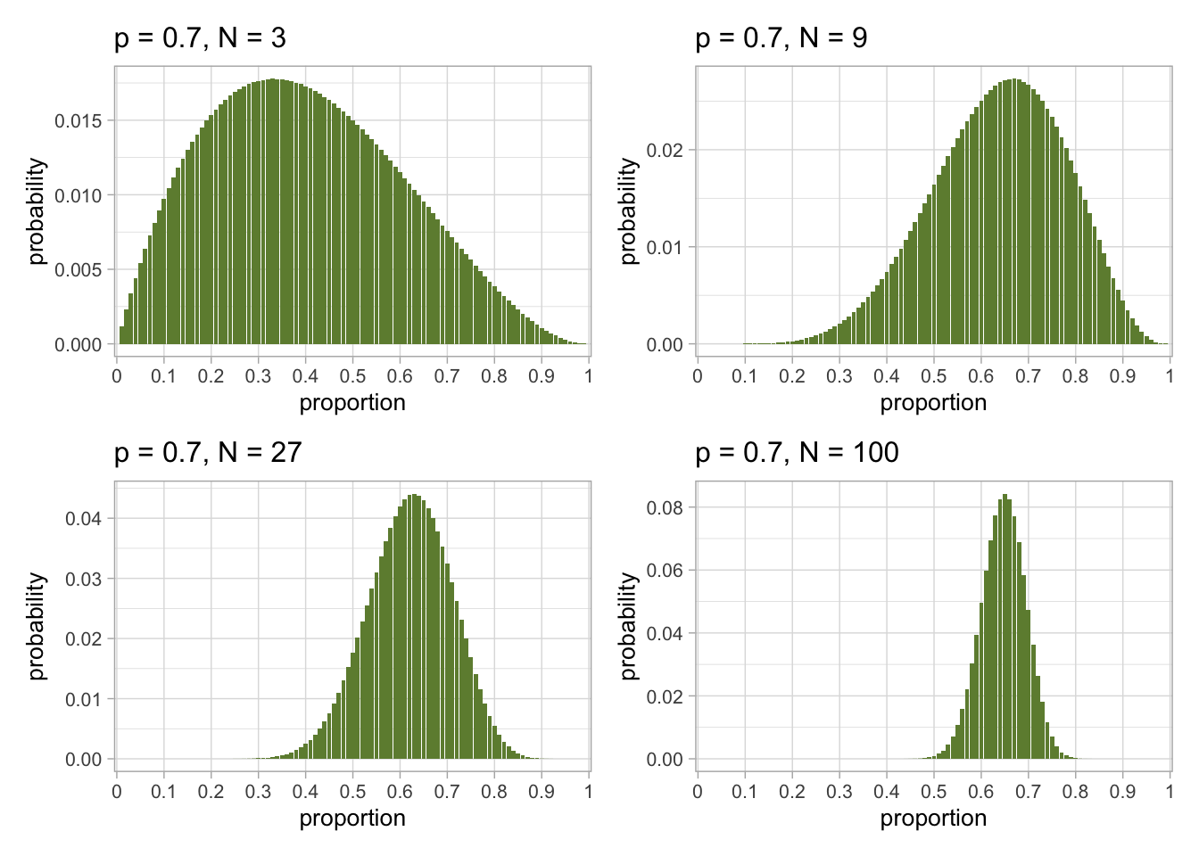
Make more observations (100 faces)
Notes:
We can simulate individual experiments with 3, 9, 27, and 100 observations, plotting the results for our estimates
Because we simulated the data, we know what the true underlying proportion was
Here the proportion is p=0.7
As the number of observations increases, the modal estimate tends to be closer to the true value of p=0.7, and the spread of the distribution narrows.
But note that the “true” value is not the most probable value in any of these simulations
Any measurement is an estimate, and has uncertainty in it.

Slide 29
Sample size
Sample size is a central concern of experimental design
Too few observations = uncertainty in results, or incorrect results
Too many observations = wasted time and resources
In animal experiments, we also want to minimize animal suffering – as few experimental subjects as necessary (3Rs)
We want to collect an optimal number of observations to give robust results at an acceptable (financial and ethical) cost
Notes:
Sample size is a central concern of experimental design in general.
Collecting too few observations leads to increased uncertainty in our estimated values
This uncertainty can make it more difficult to achieve a statistically convincing result
Collecting too many observations consumes time, resources, and money
Funding and researcher time is limited for experiments
Collecting an optimal number of observations provides statisticaly robust results at a reasonable cost
Sample size is a particular concern in animal experiments, because there is an additional concern to reduce or eliminate animal suffering.
As is the case for all experiments, we want to choose a sample size that is large enough, so we can estimate quantities accurately enough and with enough precision that our statistical analysis is informative.
But in addition, we need to choose the smallest possible sample size that allows this, in order to minimise the ethical cost of the experiment, in terms of animal suffering.

Slide 30
Statistical Power
Statistical power tells us what conclusions can reasonably be drawn from statistical analysis of our experiment
Notes:
In this section, we will consider the concept of statistical power, and learn how to calculate sample sizes with a widely-used software tool called G*Power

Slide 31
Statistical power
Statistical power is the probability, before a study is performed, that a particular comparison will achieve “statistical significance” at some predetermined level.
More precisely, statistical power is the probability that the study will not return a false negative result (known in statistics jargon as a “Type II error”)
As researchers we have two choices to make:
What threshold of statistical significance (“type I errors”, p-value, or 𝞪) is appropriate?
What rate of false negative results (“type II errors” or 1-𝞫) is acceptable to us at that significance level? (i.e. what statistical power do we want?)
Notes:
Statistical power is the probability, before a study is performed, that a particular comparison will achieve “statistical significance” at some predetermined level.
More precisely, statistical power is the probability that the study will not return a false negative result, known in statistics jargon as a “Type II error”.
There are two decisions we need to make as researchers, if we want to design an experiment to have a certain statistical power:
What threshold of statistical significance (“type I errors”, p-value, or alpha) is appropriate?
What rate of false negative results (“type II errors”, 1-beta) is acceptable to us at that significance level? (i.e. what statistical power do we want?)
These decisions are in your hands as the researcher although, as we will see, there may be constraints from outside sources, such as funding bodies.

Slide 32



Type I and Type II errors
WOLF
NO
WOLF
Boy cries wolf
There’s a wolf
Village is happy
Boy cries wolf
There’s no wolf
Village is unhappy
FALSE POSITIVE
TYPE I ERROR
CRIES
Boy doesn’t cry wolf
There’s a wolf
Village is unhappy
FALSE NEGATIVE
TYPE II ERROR
Boy doesn’t cry wolf
There’s no wolf
Village is happy
DOES NOT CRY
Notes:
I always used to get confused about Type I and Type II errors.
You also know them maybe as false positives and false negatives.
One way to understand them is through one of Aesop’s Fables: The Boy Who Cried Wolf.
If you don’t know it, a small boy is tasked with guarding the sheep for the village. He’s meant to cry wolf “There’s a wolf!” when he sees a wolf, so the village can defend their mutton supply.
Being a small boy, he gets bored and keeps shouting that there’s a wolf, when there is none.
The boy was committing a FALSE POSITIVE, or TYPE I ERROR.
Rather than replace or revise the faulty statistical test…
I mean, rather than get someone more reliable instead, the villagers persist with the boy.
But one day, a wolf really does come.
Unfortunately, the villagers think it’s another Type I error and ignore him.
The sheep get eaten and the boy is punished, but the villagers are at least as much to blame because they had plenty of chance to fix their test/replace the boy.
Anyway, a type II error is the other kind of faulty wolf-detector and happens when the boy sees the wolf but does not raise the alarm.
In statistics, we try to minimize both. But for any particular analysis it may be worse to have a false positive than a false negative - or worse to have a false negative than a false positive.

Slide 33
Statistical power and sample size
Sample size is the number of experimental units (often, but not always, individuals in this context) used per group in the experiment.
The sample size for an experiment involving animals should be determined by a statistical power calculation and chosen such that the experiment is neither underpowered nor overpowered.
Underpowered: too few subjects to interpret the experiment properly
Overpowered: so many subjects that we are wasteful of time and/or resources, or cause excess suffering
There is no universally applicable sample size.
An appropriate sample size should be calculated specifically for each experiment.
Notes:
Sample size is the number of experimental units (often, but not always, individuals in this context) used per group in the experiment.
The sample size for an experiment involving animals should be informed by a statistical power calculation and chosen such that the experiment is neither underpowered nor overpowered.
There is no universally applicable sample size. An appropriate sample size should be calculated specifically for each experiment.
Anyone who tells you “use n=6 because we’ve always done it that way” is not to be trusted
We can use power calculations to determine appropriate sample sizes.

Slide 34
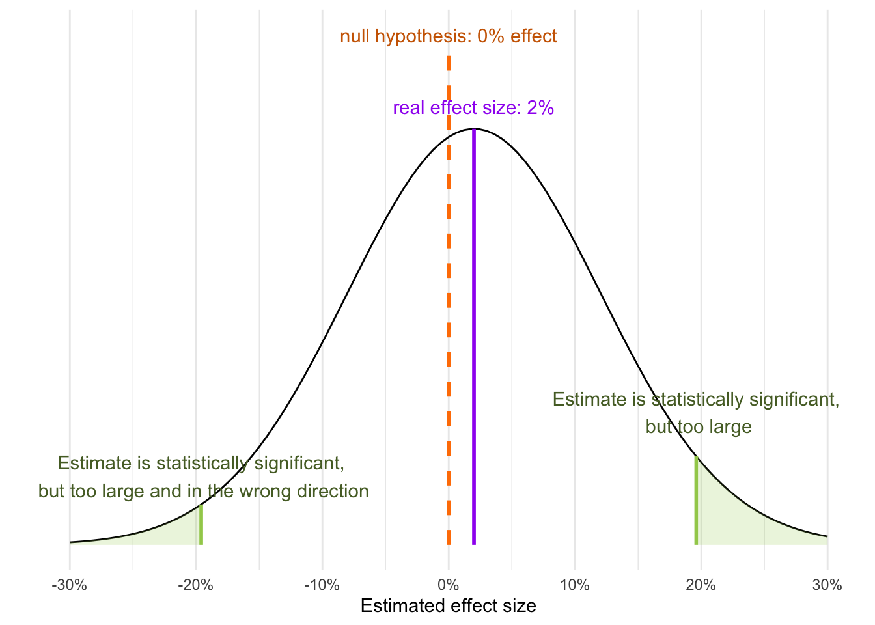
Underpowered studies
Studies are underpowered if the expected effect size is small in relation to the variation (e.g. standard error) of the measurement.
Too few subjects
Noisy nuisance variables
Too small an effect size
It is NOT true that if the effects are large enough to be seen in a small study they must be real large effects
Notes:
We sometimes refer to studies as being “low-powered” or “underpowered.” What we mean by this is that the expected effect size is small in relation to the variation (e.g. standard error) of the measurement. Low power in studies might result from any number of reasons, such as the experiment involving too few experimental units (e.g. individual subjects), or from measurements having relatively high variability due to the effect of noisy nuisance variables.
Underpowered studies may not give a statistically significant result even when a relatively large effect is found in the experiment. Worse still, because a very large effect may be required to reach statistical significance, any “positive” result (rejecting the null hypothesis) is likely to be a statistical outlier and not reflect the true effect size.
It is NOT true that if the effects are large enough to be seen in a small study they must be real large effects
When effect size is small compared to the standard error of the measurement, statistical power is low, and the study is underpowered.
In this figure, the null hypothesis is that there is no effect (orange dashed line).
The real effect size of the intervention under study is assumed to be 2% of the size of the control (the purple solid line), and estimates are assumed to have the same standard error as the control experiment.
The black curve represents the distribution of possible estimates of effect size as a Normal distribution with mean=2%, sd=10%.
The shape of the curve shows that statistical significance is unlikely to be achieved (we would need a 19% effect size, with this level of variation) but, if it is achieved, it is misleading, as there is a reasonable chance (39%) that the significant result will be in the wrong direction and, in any case, the magnitude of the effect size will be greatly overestimated.
In the figure 5% of the outcomes give ”statistically significant” results
But 40% of those results are negative values of 20% or more
The other 60% are positive values of 20% or more
Either way, the “statistically significant result” is misleading

Slide 35
Ethical costs
As stated in the NC3Rs EDA guide,
“Under-powered in vivo experiments waste time and resources, lead to unnecessary animal suffering, and result in erroneous biological conclusions.”
Similarly, over-powered experiments in which more animals than necessary are used to establish a result also lead to unnecessary animal suffering and are unethical.
“Ethically, when working with animals we need to conduct a harm–benefit analysis to ensure the animal use is justified for the scientific gain. Experiments should be robust, not use more or fewer animals than necessary, and truly add to the knowledge base of science.” (Karp and Fry (2021)).
Notes:
The primary cost of an experiment involving animals is ethical, and measured in the potential for animal suffering.
The financial cost is a secondary consideration.
Funders will typically fund, and ethics bodies approve, the experiment most likely to give robust and useful results in an ethical manner, not the cheapest experiment possible.

Slide 36
Increasing statistical power
Reduce the variability in the experiment
Control for nuisance effects
Make precise measurements/estimates
Increase the number of experimental units
Using more experimental units reduces the estimated error of the mean
2x sample size reduces standard error 1.4x
Increase the effect size
More effective than increasing sample size (2x effect size better than 1.4x reduction in standard error)
Notes:
There are three broad strategies available to us, as researchers, to increase the statistical power of an experiment:
Reduce the variability in the experiment
this typically means controlling for nuisance effects that cause variation in experimental units, or improving the way we measure outcome variables
Increase the number of experimental units
when we increase the number of experimental units, we reduce the uncertainty in our estimate of error of the mean
Increase the effect size
this might not always be under researcher control but might be modulated by, say, changing the concentration of an administered drug
There are several ways to maximise effect size, including:
setting doses as low as ethically possible in the control group, and as high as ethically possible in the treeatment group.
choosing individuals that are especially likely to respond to the treatment
Designing an experiment with the aim of increasing effect size can be difficult, and lead to other issues.
When drug concentrations are set to extreme values it can make the interpretation of the results when drugs are delivered at more realistic therapeutic levels doubtful.
If a highly sensitive set of individuals is used in the experiment, then the results may again not generalise well across the wider population.

Slide 37
Live Demo: G*Power
Is the average weight of a group of mice statistically different from 25g?
It’s a simple experiment, but we still need to answer some questions:
What statistical test do we want to perform?
What do we want to know from the analysis?
What kind of power analysis do we want to carry out?
What statistical power do we want?
What is the expected effect size, and expected variation in the sample?
Notes:
In this walkthrough we will consider a simple statistical analysis to determine whether the average weight of a group of mice is statistically different from 25g.
What statistical test do we want to perform?
We know that mean values of samples from populations tend to follow a Normal distribution, so this suggests a t-test is appropriate.
We are testing the mean of a sample against a single hypothesised central value, so this is a one-sample t-test.
As we want to know if the sample mean is different from that single stated value, we require a two-tailed test.
What do we want to know from the analysis?
We want to determine an appropriate sample size for our experiment
What kind of power analysis do we want to carry out?
As we want to know a good sample size for our experiment, before the experiment is conducted, this is an a priori power calculation.
What statistical power do we want?
We will use a standard funder’s requirements of 80% power at a
threshold for statistical significance. i.e. alpha = 0.05, beta = 0.2, 1-beta = 0.8
What is the expected effect size, and expected variation in the sample?
We will assume that a 10% difference in weight from the target 25g is meaningful, for an effect size of 2.5g.
We will assume that the weight of individuals in the sample has a standard deviation of about 1.25g
i.e. Sigma = 1.25

Slide 38
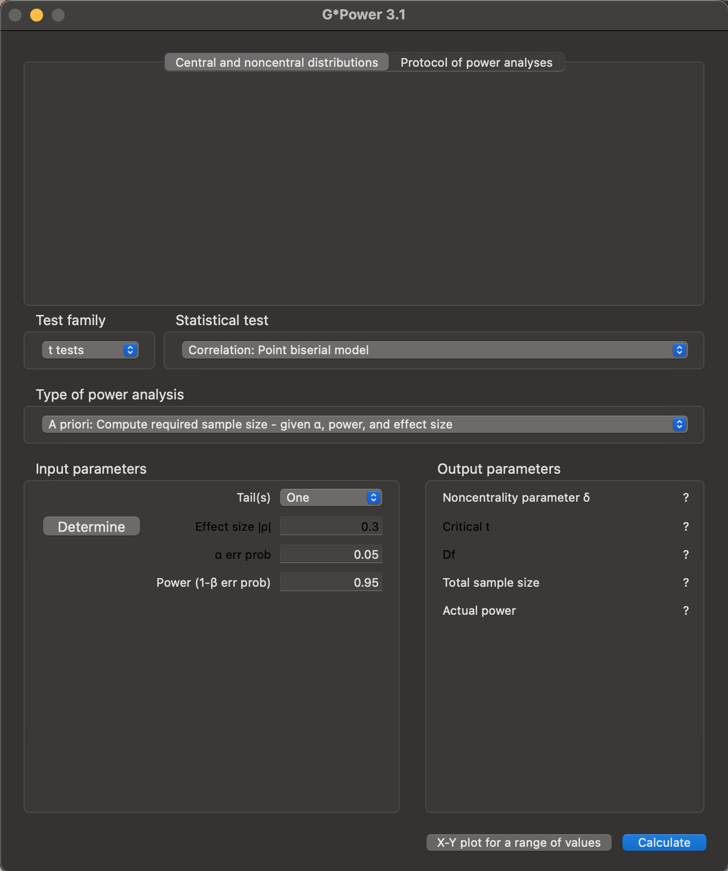
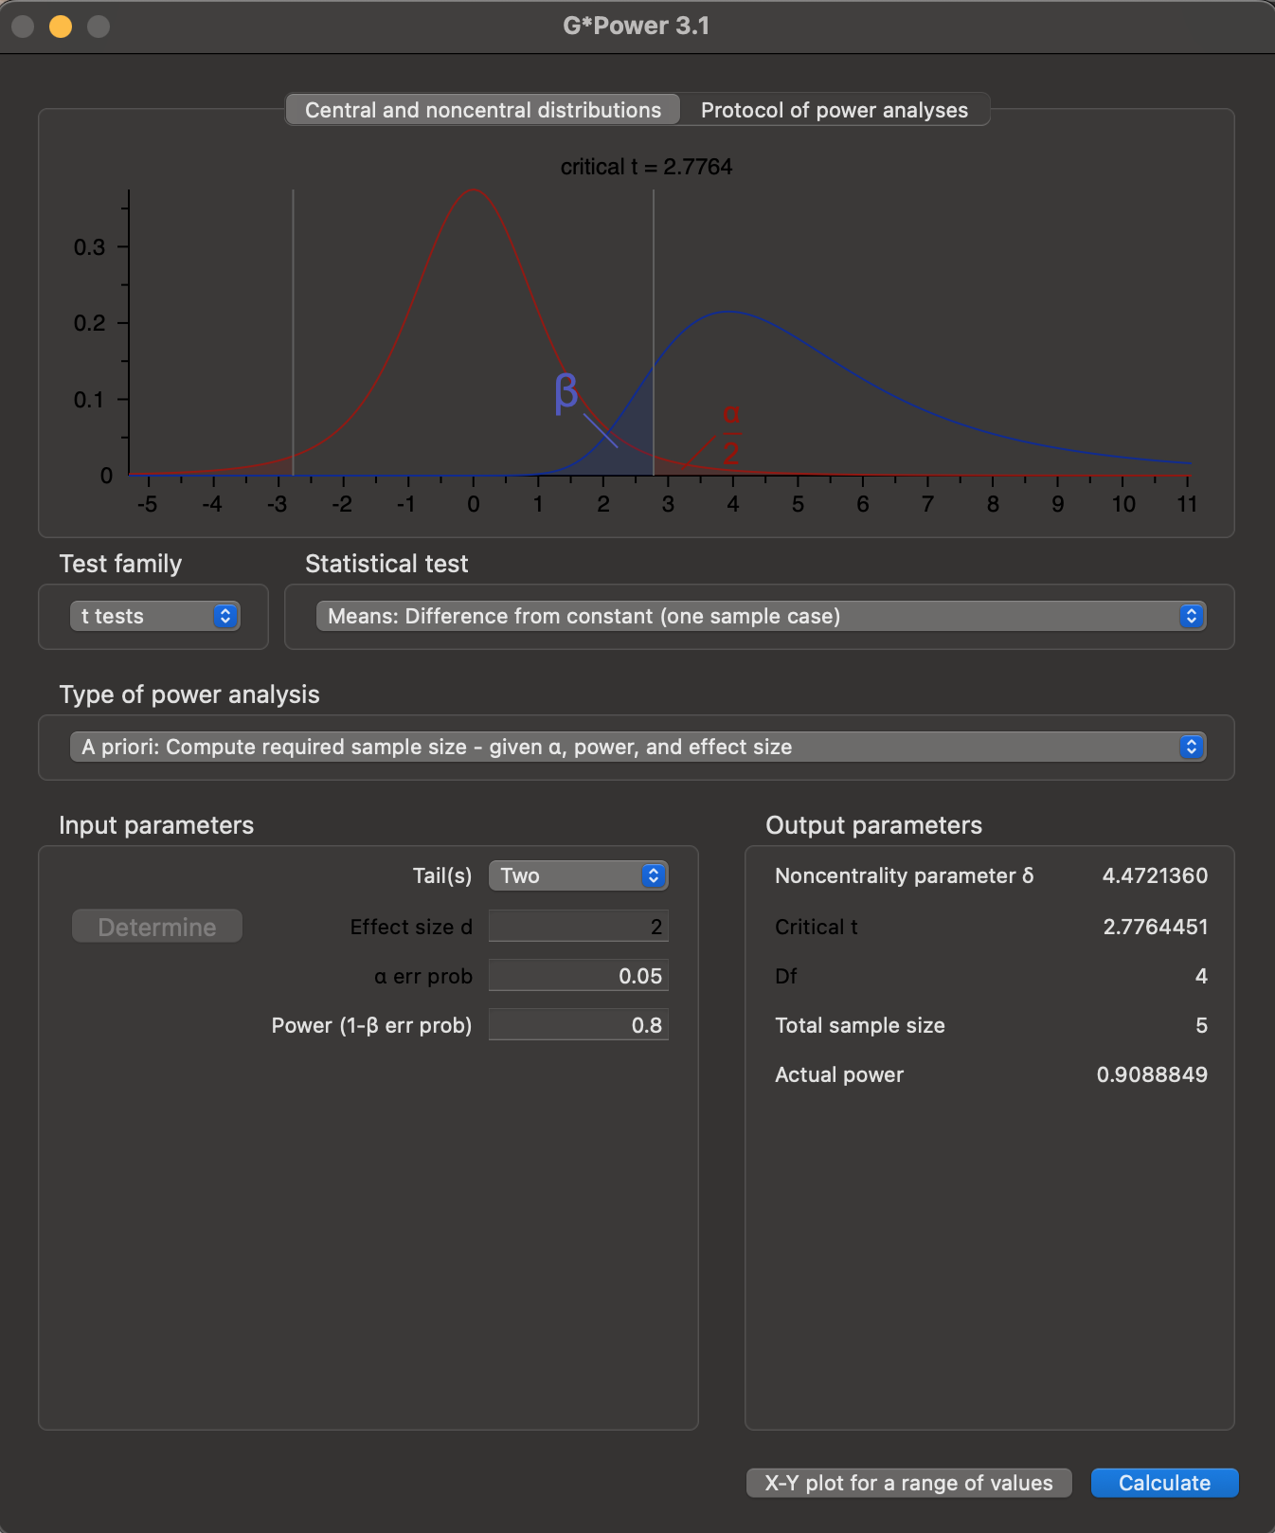
Live Demo: G*Power

Slide 39
Let’s have a wee break
We’ve got a long walkthrough coming up…

Slide 40
NC3Rs EDA
Online experimental design, critique, and analysis tool walkthrough
Notes:
NC3Rs is a BBSRC and MRC-funded UK-based scientific organisation that works to help the research community to replace, refine, and reduce (the 3Rs) the use of animals in research and testing.
They fund 3Rs research, train early career researchers, and provide services, information, and resources to the scientific community, animal care staff, and vets
The NC3Rs provides the Experimental Design Assistant (EDA), an online tool that helps researchers design robust experiments.
The researcher builds their experiment as an annotated graph representation, which the EDA tool can analyse, and on which it can provide bespoke feedback, including suggestions of suitable statistical approaches.
The EDA also produces helpful visualisations of the experimental design, which can be shared with others and in publications, for transparency and clear communication..

Slide 41
Our Experiment
Test for the effect of a novel drug on glucose levels in the plasma of diabetic mice.
“We will use NONcNZO10/LtJ mice (JAX) to represent a polygenic form of diabetes. Mice in the treatment group will receive a single subcutaneous injection of drug A (up to 30mg/kg). Mice in the control group will receive a single subcutaneous injection of vehicle. Mice will be randomly assigned to receive either drug A or vehicle only without regard to the sex of the animal. 48 hours after administration of drug or vehicle, the blood glucose level will be measured.”
Notes:
In this workshop we are going to build an EDA diagram from scratch to represent a simple experiment with the aim to test for the effect of novel drug on glucose levels in the plasma of diabetic mice.
We can describe our experiment in the usual way we’d approach writing a grant application (or, in the past tense, a Methods section) as something like:
We will use NONcNZO10/LtJ mice (JAX) to represent a polygenic form of diabetes. Mice in the treatment group will receive a single subcutaneous injection of drug A (up to 30mg/kg). Mice in the control group will receive a single subcutaneous injection of vehicle. Mice will be randomly assigned to receive either drug A or vehicle only without regard to the sex of the animal. 48 hours after administration of drug or vehicle, the blood glucose level will be measured.
This is a concise and accurate description of the experiment but, as is good practice, we will begin by laying out what we understand about the experiment that is relevant to the design.

Slide 42
Our beliefs about the experiment
We are testing the effect of a new drug - drug A - on plasma glucose levels
There is a single experimental variable of interest: whether drug A is present (treatment) or absent (control)
The plasma glucose level is our outcome measure
Our experimental subjects are diabetic (NONcNZO10/LtJ) mice
We will divide individuals into two groups, by different pharmacological treatment
Group 1 will receive the vehicle with no active drug (the control)
Group 2 will receive the vehicle, containing active drug (the treatment)
Individuals will be allocated to each group randomly, by complete randomisation
We are not testing for the effect of sex on drug performance as an experimental variable of interest

Slide 43
Causal Relationships
The outcome variable, plasma glucose concentration, is dependent on
the pharmacological effect of drug A
the pharmacological effect of the vehicle
individual differences between experimental subjects (mice)
Notes:
For the experiment we are building in our EDA example, we assume that the outcome variable, plasma glucose level, is potentially dependent on three causal relationships:
the pharmacological effect of drug A
the pharmacological effect of the vehicle
individual differences between experimental subjects (mice)

Slide 44
Effect of drug A
“treatment” vs “no treatment”
In statistical terms, the presence or absence of drug A is our independent variable or explanatory variable.
Whether drug A is administered or not is entirely under our control, as experimenters.
Notes:
The causal influence of administering drug A (or not) on the plasma glucose levels of our experimental subjects is the central reason for performing this experiment. Naturally then, we would want to compare what happens to plasma glucose levels when we intervene with drug A, and when we do not.
There are several ways to structure such a comparison, but this research question naturally suggests the use of two experimental groups: one receiving drug A, and one not. We can assume that the results for these groups are each representative of a much larger population, for which the effect of introducing drug A (or not) follows the shape of a parametrisable statistical distribution, like a Normal distribution.

Slide 45
“control” vs “treatment”
Drug A, like most drugs, is carried in a vehicle - a substance expected to be inert in the context of the treatment.
In our experiment we use two pharmacological interventions:
injection of a vehicle (control)
injection of a vehicle containing drug A (treatment)
Notes:
Unfortunately, we cannot administer the drug in isolation. Drug A, like most drugs, is carried in a vehicle - a substance expected to be inert in the context of the treatment.
It would be possible, but unwise, to assume that we could administer drug A alone to one group of mice, and apply no intervention to the other. We are measuring a physiological response which might be affected by many other processes, including the individual being subject to an injection. It might not be correct to assume that the vehicle is inert, either. So we must follow the same protocol as closely as possible in a control group, where the only difference under our control between control and treatment is the presence or absence of drug A.
Practically then, in our experiment we use two pharmacological interventions:
injection of a vehicle (control)
injection of a vehicle containing drug A (treatment)
We assume that any variation between individual vehicle preparations (or the experimental subjects’ responses to them) are effectively “drawn from the same population,” and that both groups experience the same causal influence from the injection process, and the introduction of the vehicle. As a consequence we assume that any observed difference between the groups is the result of either receiving drug A, or not receiving it.

Slide 46
Assignment of individuals to groups
underlying differences between individuals - is accounted for by randomising subjects into experimental groups:
Treatment (vehicle + drug)
Control (vehicle)
we assume that all individuals are “drawn from the same population,”
each mouse is a random choice from a single pool whose underlying plasma glucose level is distributed according to some kind of regular (potentially parameterisable) statistical distribution
Notes:
The remaining potential causal influence we consider - that due to underlying differences between individuals - is accounted for in our experimental design by randomising subjects into experimental groups (treatment and contro)
.
This works because we assume that all individuals are “drawn from the same population,” such that each mouse as a random choice from a single pool whose underlying plasma glucose level is distributed according to some kind of regular (potentially parametrisable) statistical distribution. This is usually a reasonable assumption, and implies that the groups are samples from the same larger population, so should have similar properties
The important consequence of this is that we can argue that - before we intervene with the experimental treatments - we should expect the underlying plasma distribution levels of our treatment and control groups to be comparable. Any differences in measured outcome should then be expected to derive only from our experimental interventions and, in particular, only from the presence or absence of drug A.

Slide 47
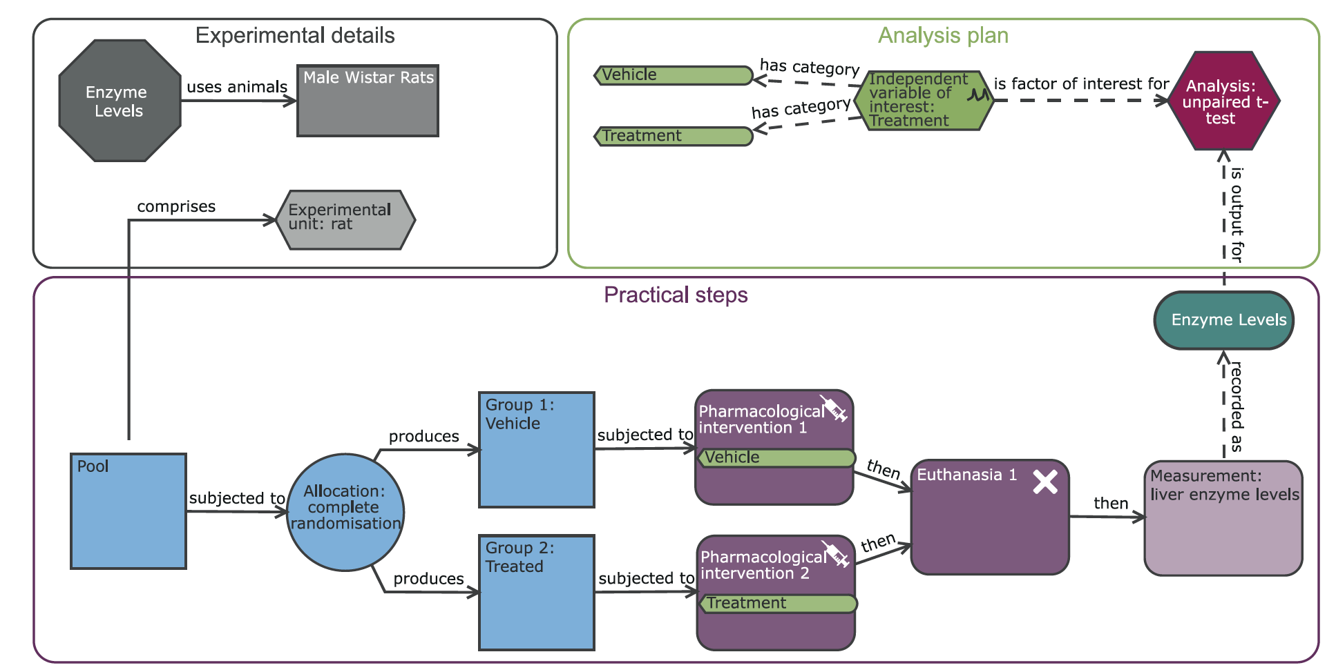
EDA Diagrams
Notes:
EDA diagrams are composed of nodes (shapes) and links (arrows). The nodes represent aspects of an experiment and the links represent the relationships between nodes. An EDA diagram describes three elements of an experimental design: experiment detail (grey nodes), practical steps (blue and purple nodes), and the analysis plan (green and red nodes). Nodes can be annotated with additional information.
An EDA diagram can be thought of as describing three aspects of an experiment
experiment detail (grey nodes): Information about the experimental units and subjects, such as sex and genotype
practical steps (blue and purple nodes): actions that will be taken during the experiment, including pooling and experimental group allocation, surgical or pharmaceutical interventions, and outcome measurements
the analysis plan (green and red nodes): components of a statistical analysis (i.e. explanatory, independent, and nuisance variables, and covariates), and the analysis itself

Slide 48
Live Demo: NC3Rs EDA

Slide 49
Summary
What I hope I’ve been able to explain

Slide 50
Cause and Effect
the data you collect does not contain information about causes and effects
your beliefs and assumptions about an experiment are the causal model for that experiment
Notes:
we considered the fundamental issue that the data you collect does not contain information about causes and effects.
Specifically, we discussed how your beliefs and assumptions about an experiment are the causal model for that experiment, and that your experimental design reflects those beliefs.

Slide 51
Sample size and measurement
the values we collect in an experiment lead to estimates of “true” values
causal graphs explain our beliefs about what variables affect our experimental measurements
the number of experimental units affects the precision and confidence we can have in our estimated value

Slide 52
Power calculations
statistical power tells us what conclusions can reasonably be drawn from statistical analysis
underpowered experiments lead to uninformative results and misleading conclusions
it is usually better to design your experiment to increase effect size/minimise noisy variation than to increase sample size
how to estimate sample size for a desired statistical power

Slide 53
NC3Rs EDA
How to design, critique, and analyse an experiment using the NC3Rs EDA tool, and share the resulting design with others.

Slide 54
Final notes
Please see the support materials online at
https://sipbs-compbiol.github.io/MP968-Workshop_Experimental_Design
Links to these slides, and the support material, can be found on the MP968 MyPlace page
https://classes.myplace.strath.ac.uk/course/view.php?id=15691
Notes:
Experimental design is a large and diverse field, and to become competent in experimental design takes time, and requires practice (which also involves making mistakes, at times).
It requires some knowledge and understanding of statistics, applied mathematics, and a detailed understanding of the scientific field that you are working in.
No single workshop can tell you everything you need to know about experimental design - in fact, as researchers we never stop learning about experimental design –
but there are excellent resources available to help you, whatever stage of your career you are at.
Please do use the Further Reading section as a jumping-off point to learn more as you continue your journey as a scientist.

